Slide 1
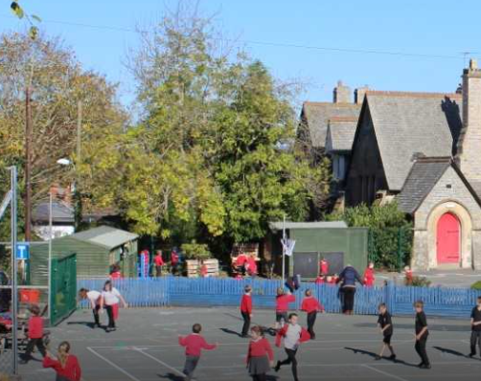

Montgomery CiW School
Happily growing together to be the best that we can be!

Slide 2

Our vision is to have a school where…
In God's love we are all happily growing together to be the best that we can be!

Slide 3
To help us achieve this we…
teach Christian values through the experiences offered to pupils and through serving our community by providing an education of the highest quality.
provide an environment where children can feel happy and secure, where they are not afraid to make mistakes, and everyone is valued for their individuality.
believe that children should be taught to value their surroundings, their sense of Cynefin and gain satisfaction from achieving their potential.
model care and respect for one another so children learn and earn the respect of their peers and adults alike.
teach understanding of the concepts of respect, kindness, faith, trust, honesty, tolerance and friendship.
respect every individual’s contribution to the school and the wider community.
support the children in building positive relationships.

Slide 4
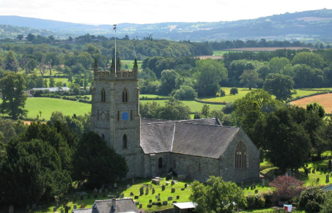
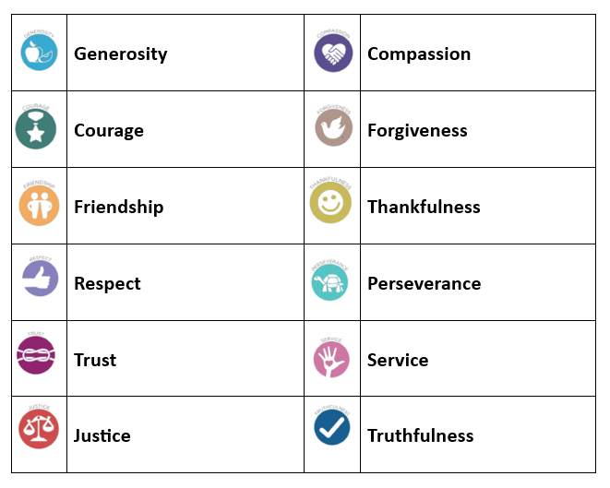

Our Christian Values
As a Church in Wales School our links to our Christian faith are important to us. We have strong connections with St Nicholas Church and our parish.
We learn the importance of Christian Values through regular Collective Worship and daily prayer. We welcome Reverend Paulette, Reverend Mary, Impact and the Open the Book team into school each half term to help us celebrate our faith.

Slide 5
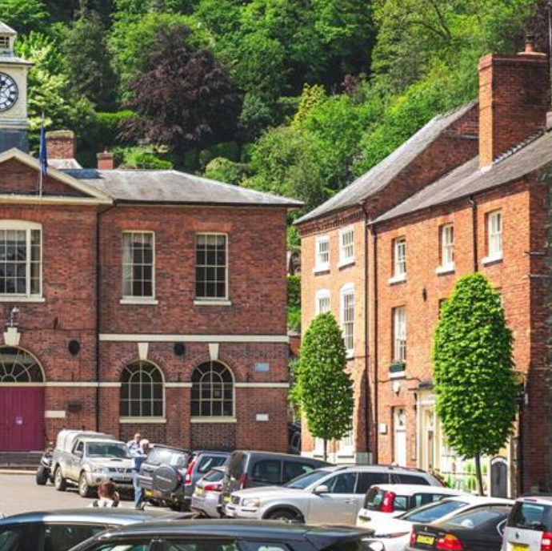
Our School in Montgomery
Montgomery is a small market town that is steeped in history. As a small-town school, we value the relationships we have with our local community. Our new curriculum enables us to embrace our sense of belonging to our local area as we embrace learning opportunities that surround us.

Slide 6




Our Four Purpose Vision
At Montgomery CiW School we develop ambitious, capable learners who:
set themselves high standards and seek and enjoy challenges
are building up a body of knowledge and have the skills to connect and apply that knowledge in different contexts
are questioning and enjoy solving problems
can communicate effectively in different forms and settings, using both Welsh and English
can explain the ideas and concepts they are learning about
can use number effectively in different contexts
understand how to interpret data and apply mathematical concepts
use digital technologies creatively to communicate, find and analyse information
undertake research and evaluate critically what they find
and are ready to learn throughout their lives
.
At Montgomery CiW School we develop healthy, confident individuals who:
have secure values and are establishing their spiritual and ethical beliefs
are building their mental and emotional well-being by developing confidence, resilience and empathy
apply knowledge about the impact of diet and exercise on physical and mental health in their daily lives
know how to find the information and support to keep safe and well
take part in physical activity
take measured decisions about lifestyle and manage risk
have the confidence to participate in performances
form positive relationships based upon trust and mutual respect
face and overcome challenges
have the skills and knowledge to manage everyday life as independently as they can
and are ready to lead fulfilling lives as valued members of society
At Montgomery CiW School we develop ethically, informed pupils who :
find, evaluate and use evidence in forming views
engage with contemporary issues based upon their knowledge and values
understand and exercise their human and democratic responsibilities and rights
understand and consider the impact of their actions when making choices and acting
are knowledgeable about their culture, community, society and the world, now and in the past
respect the needs and rights of others, as a member of a diverse society
show their commitment to the sustainability of the planet
and are ready to be citizens of Wales and the world
At Montgomery CiW School we develop enterprising, creative contributors who:
connect and apply their knowledge and skills to create ideas and products
think creatively to reframe and solve problems
identify and grasp opportunities
take measured risks
lead and play different roles in teams effectively and responsibly
express ideas and emotions through different media
give of their energy and skills so that other people will benefit
and are ready to play a full part in life and work

Slide 7
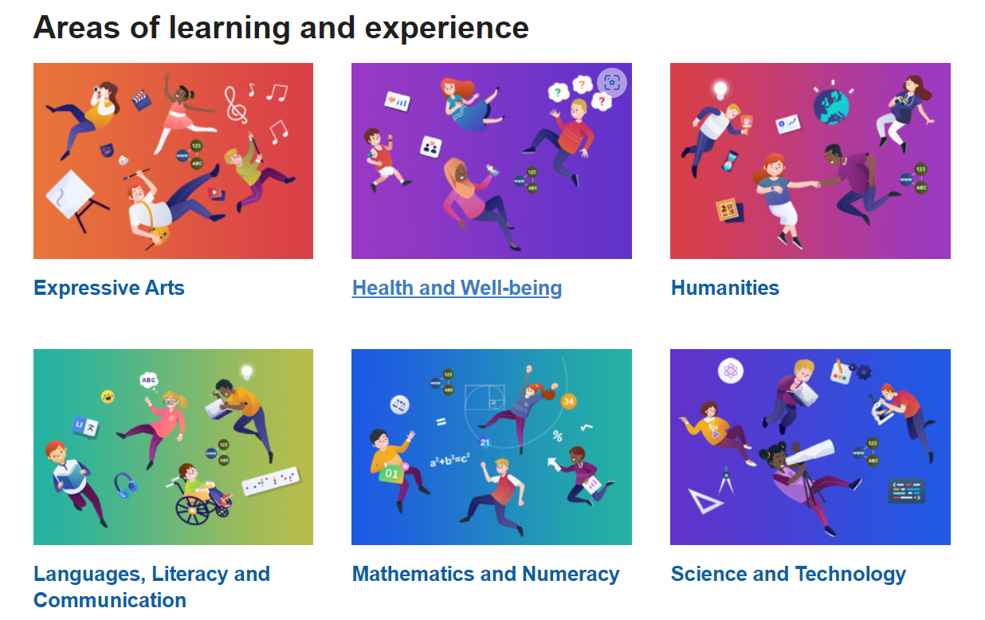

Slide 8
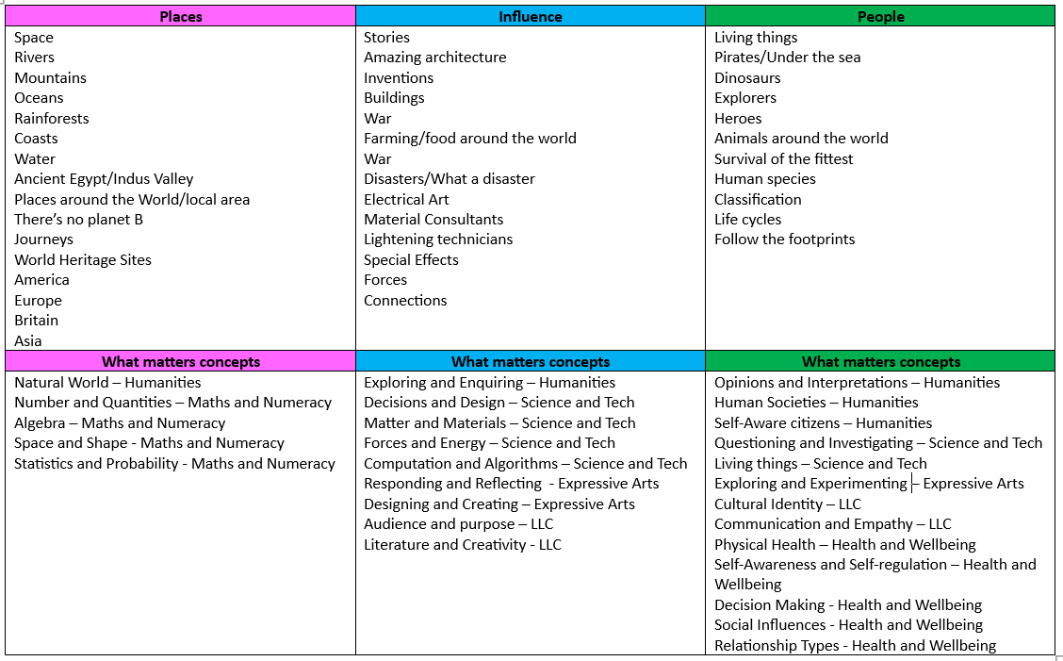
Curriculum Mapping –Sept 2022
We explored the areas of the current curriculum that the pupils’ enjoyed and then segmented these to cover three main themes. We then cross referenced these to the Statements of What Matters

Slide 9
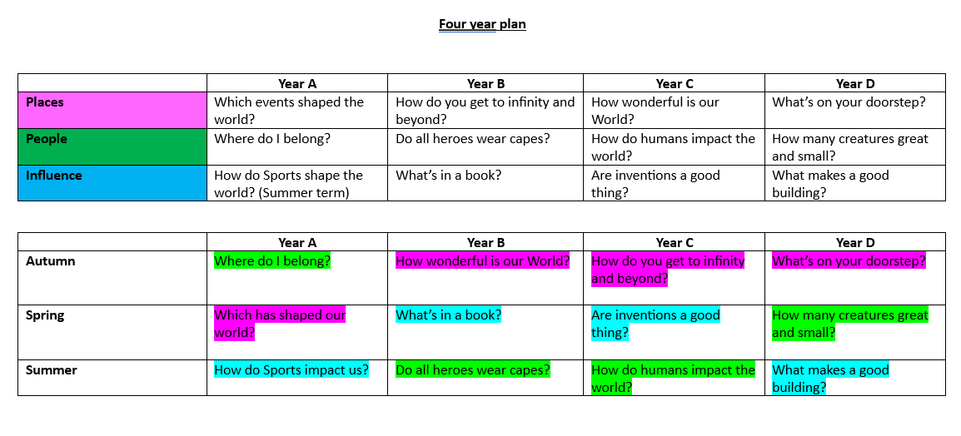
Our Big Questions
To ensure continuity of learning across the school, whist providing pupils choice in the direction of their learning, we will use Big Questions each term.

Slide 10
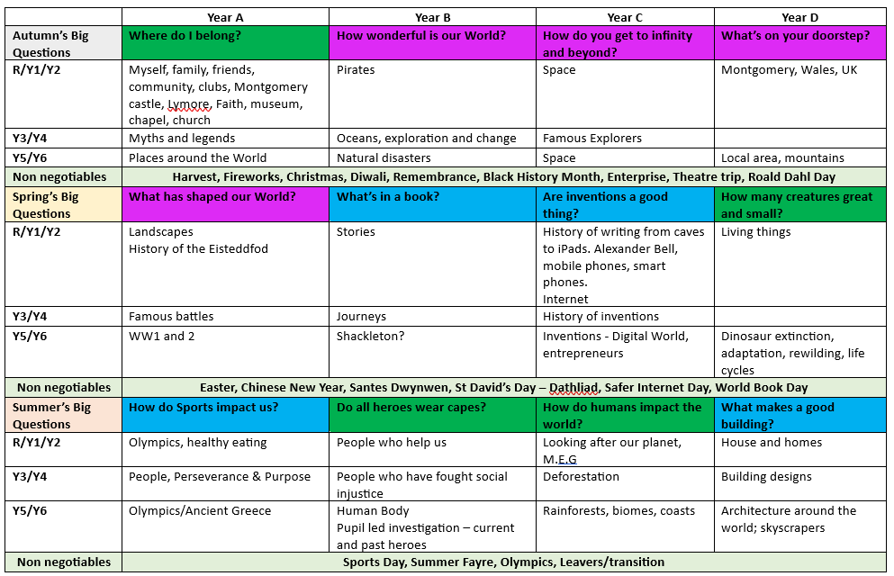
Planning for Progression

Slide 11
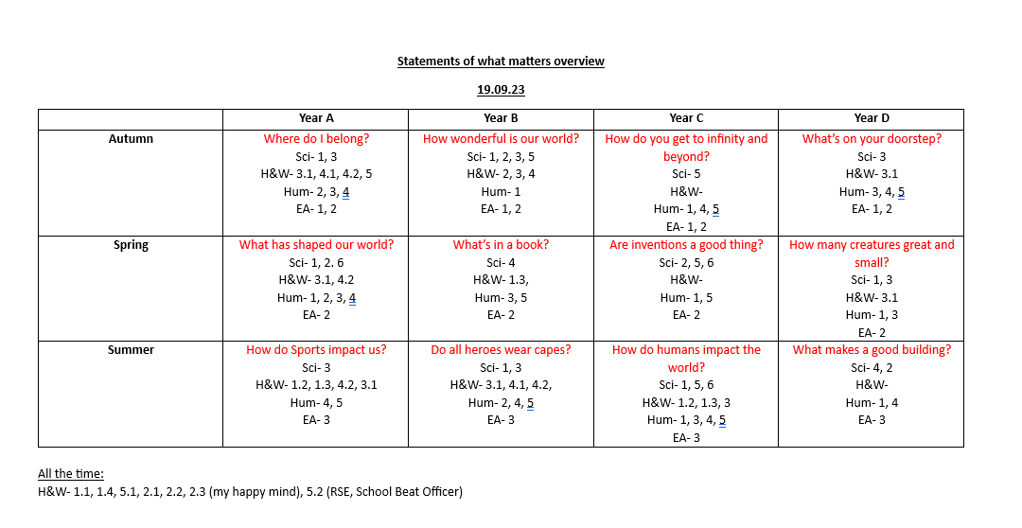
As a cluster we have developed concept maps for each of the key concepts in the New Curriculum. We have mapped these across our Big Questions to ensure coverage.
Cluster Collaboration

Slide 12
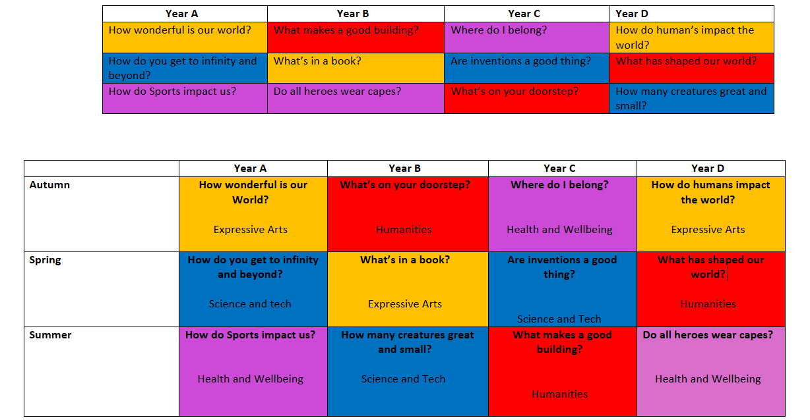
Evolving process – reviewed and adapted June 2024

Slide 13
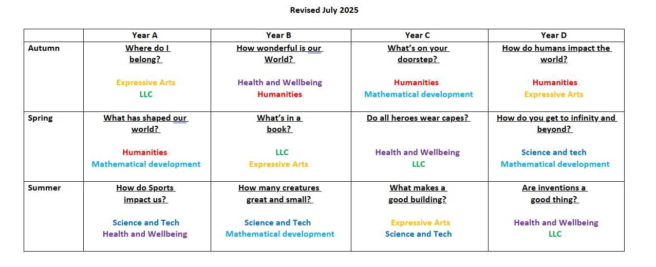
Further adapted...Revised July 2025

Slide 14
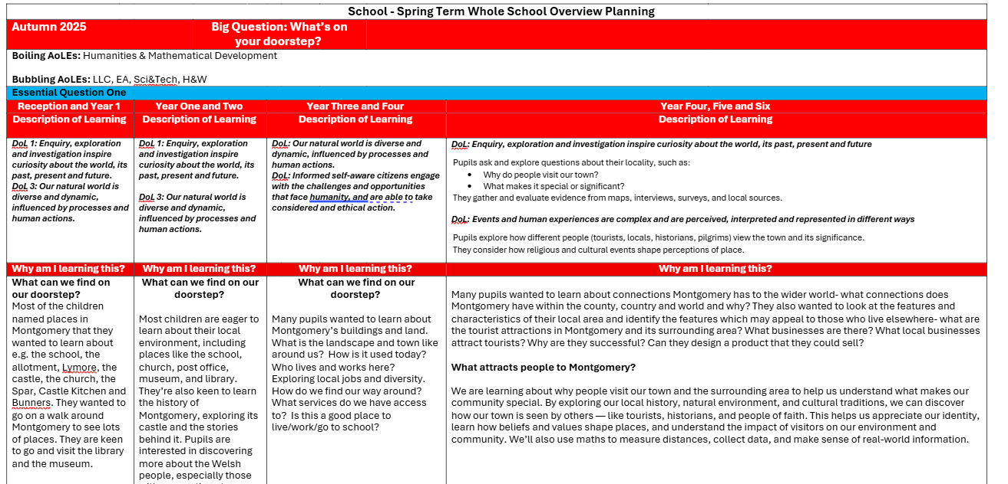
Updated Planning for Progression – Sept 2025

Slide 15
Pupil Led Learning
We value our pupils’ voice and recognise that their opinions are important and will help shape our school.
We promote pupil led learning by involving the pupils in the areas that they wish to learn about in each Big Question.
Pupils are also provided the opportunity to have choice in the way they present their work.
We regularly involve children in our monitoring processes, by asking them what they think is working well and what they would like to see improve.
Every pupil in years 2 to 6 are a member of one of our pupil voice groups. In the summer term our year 2 pupils join the groups as part of their transition.

Slide 16
We think we should have a Buddy Bench for children to go to if they need a friend
All pupils in year 3-6 are members of a pupil voice group
School Council
Eco-Committee
Criw Cymraeg
Digi Wizards
Sports Ambassadors
We will fundraise for more sports equipment
Pupil Voice Groups
We want to make our school a brighter place
We will introduce a Wal Graffiti to practice our Cymraeg
We will teach others how to be safe online

Slide 17




An Evolving Curriculum Offer
Our New Curriculum is being regularly reviewed and updated to ensure that we are offering our pupils the very best educational experiences and opportunities.
We work closely with our cluster schools and our feeder High Schools to ensure that our transitions are smooth for our year six pupils.
We work closely with our pre-school setting to ensure our early years transitions are seamless.
We work closely with the Local Authority to ensure our staff have the most up to date training in the Areas of Learning Experience.

